Slide 1
Food Deserts and Health in America
By:
Sara Simoes, Tyler Brown, Rachel Chan, and
Kasey (Kassandra) Lacerda
Notes:
Kasey

Slide 2
Summary
HYPOTHESIS: The presence of a food desert results in decreased health status for residents of the area.
RESEARCH QUESTIONS:
Do residents near food deserts have reduced health status as measured by the following characteristics: adult obesity and increased prevalence of diabetes?
PURPOSE: Our analysis aimed to understand whether the presence of food deserts deserves more or less attention from a planning perspective.
*A Food Desert can generally be defined as reduced access to healthy food measured by distance to a supermarket.
Notes:
Kasey- Urban area = 1 mile , Suburban Area = 10 miles

Slide 3
Summary
FINDINGS: We expected to see a relationship between the presence of a food desert and the various health and economic factors. We found the following:
With respect to the following factors, differences were found between populations in and outside of a food deserts for some areas:
% Obesity
The prevalence of diabetes.
Demographic distribution
Notes:
kasey

Slide 4
Data Sources
To prepare our analysis, we sought data that would identify the locations of food deserts and various health factors in the United States.
County Health Data from Robert Wood Johnson Foundation was utilized for data on obesity, diabetes, and Food Environment Index (as a measure of relativity).
Food Desert Data from the United States Department of Agriculture (USDA) for data on number of food deserts, ethnicity, poverty rate/income data, and total population per county.
Opendatasoft.com was utilized for county coordinates
Centers for Medicare and Medicaid Services (CMS) for number of medicare enrollees.
Notes:
Rachel
-For our analysis, we wanted to find data that would identify areas of low healthful food access as well as various health factors
-The County Health Data from the Robert Wood Johnson Foundation provided information on obesity, diabetes, and the Food Environment Index, which weighs both American healthy food access and income on a scale from worst to best, 0 to 10
-The USDA’s Food Desert Data gave us the food desert indicators, ethnicity, poverty rate/income data, and population information.
-We then used opendatasoft to find the coordinates and the CMS data to find the medicare population

Slide 5
Data Cleanup
Initial Data Exploration
Merged dataframe had over 300 columns/fields and many blank fields.
Realized that the data needed be aggregated because one dataset was presented in census while the other was not.
Due to size, dataframe took several minutes to merge.
Data Cleanup:
Reduced dataset: we went back to the original datasets and selected desired fields for analysis from the health and food desert datasets, resulting in approximately 40 fields (from 300).
Aggregated data to the county level appropriately (sum or average) as shown on the next slide.
Supplemental Data:
Recognized the need for additional datasets with coordinate and total number of medicare participants, and merged these into our clean dataframe.
Notes:
TYLER IS DOING THIS
We had a ridiculous amount of rows (70,000+) and each row corresponded to a different census tract. IT WAS A STUPIDLY LARGE DATASET so we aggregated errything.
We needed to choose desired fields for analysis. Mention that we needed more columns as time went on

Slide 6
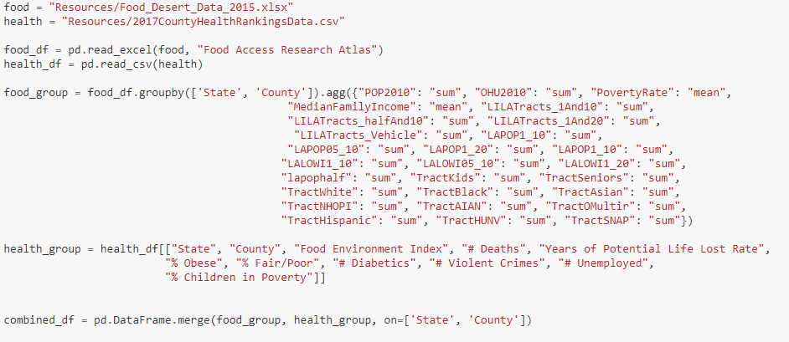
Data Cleanup
Notes:
TYLER IS DOING THIS
As you can see, some of the data is aggregated by some while others utilize mean. We basically had to identify which ones were based on population and others were based on rates.

Slide 7
Data Analysis
We prepared several types of charts (e.g. pie charts, bar charts, scatter plots, and heat maps) for various hypothetical data relationships. Charts have been selected to illustrate our analysis for each question.
We looked at the United States as a whole but also looked at the state of Montana to take a closer look at the data. We chose Montana because we were surprised to see a difference in food desert status across the state.
Notes:
Sara- we chose Montana because when looking at our initial dataframe and maps of the US, Montana was not too densely populated it was easy to see correlations or lack of correlations between the 56 counties.

Slide 8
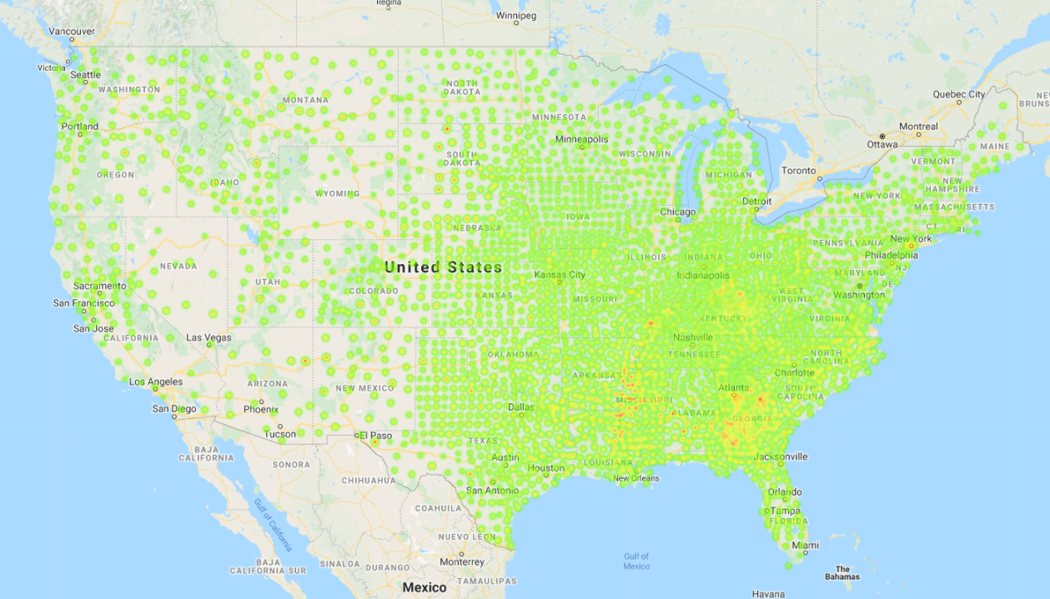
Data Analysis
Question 1:
Is the prevalence of adult obesity higher in areas with and without a food desert?
Notes:
Sara

Slide 9
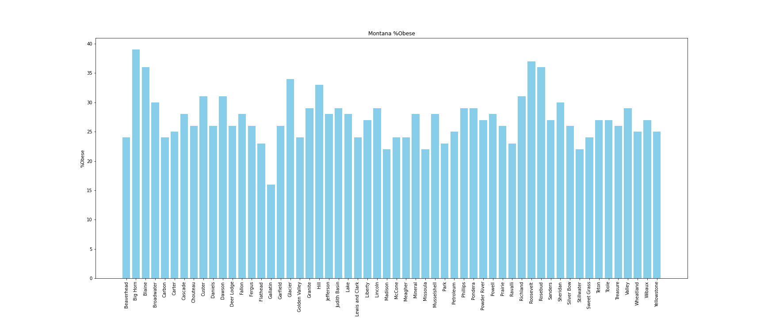
Data Analysis
Question 1:
Is the prevalence of adult obesity higher in areas with and without a food desert?
Notes:
Tyler
I used the .loc function to isolate a specific state and its counties. In this case, it was montana. Afterwards, I made a for loop to compare the county to various columns in our dataset. For this bar chart it was county vs the specific obesity percentage in that county.
Big horn (food desert) has the highest percent obese compared to a county like fergus (non food desert).

Slide 10
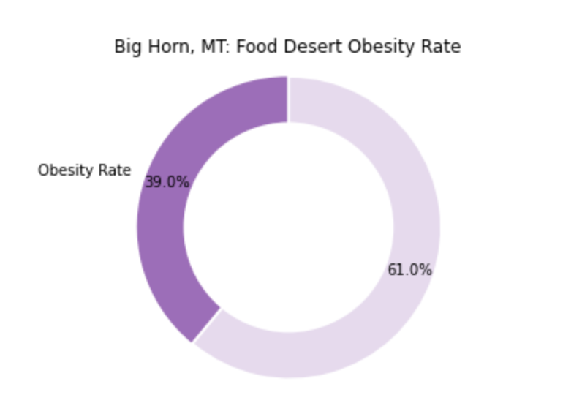
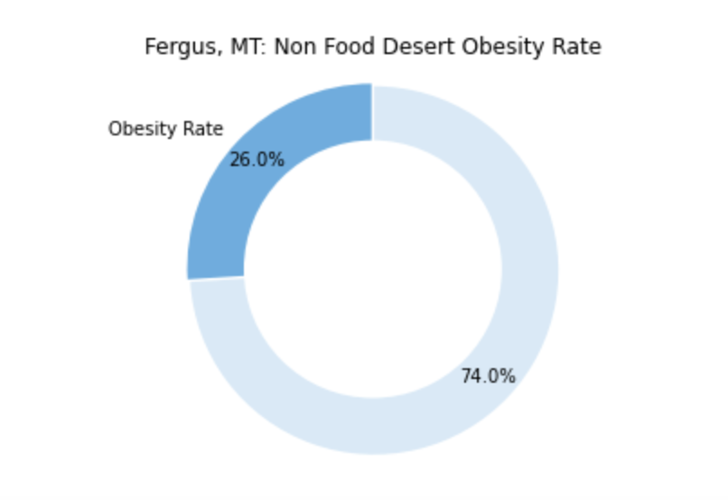
Data Analysis
Question 1: Is the prevalence of adult obesity higher in areas with and without a food desert?
Notes:
Rachel
-First, we took a look at the variable Food Environment Index and calculated the bottom 10%, which was associated with the 5.5 Food Environment Index. We used the USDA’s estimate that 10% of the census population lives in food deserts
-Based on this value, we categorized counties by food deserts and non food deserts
-In Montana, we compared the food desert Big Horn to non food desert Fergus. There was a 13 percentage point difference in obesity rate between the food desert and non food desert.

Slide 11
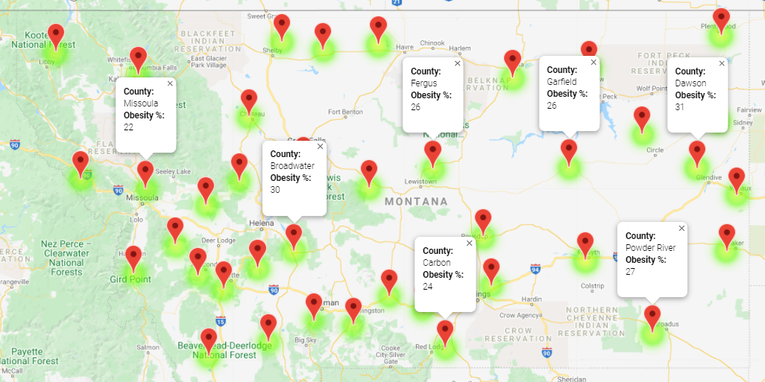
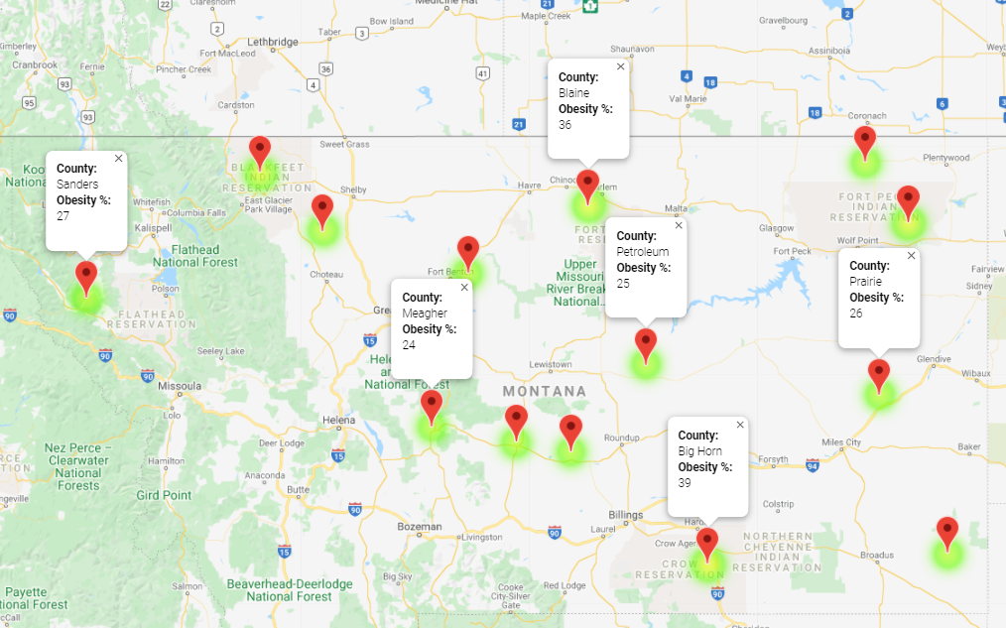
Data Analysis
Question 1:
Is the prevalence of adult obesity higher in areas with and without a food desert?
Obesity in Montana
Non-Food Desert
Food Desert
Notes:
Sara

Slide 12
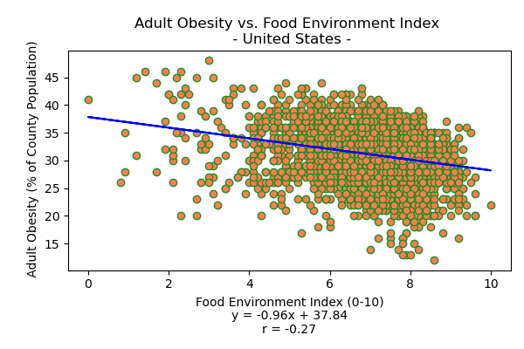
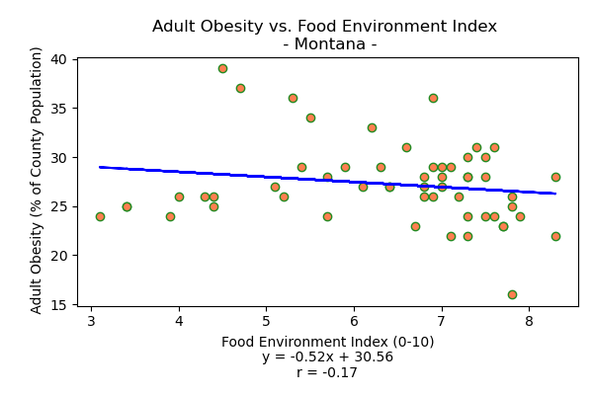
Data Analysis
Question 1: Is the prevalence of adult obesity higher in areas with and without a food desert?
Notes:
Kasey

Slide 13
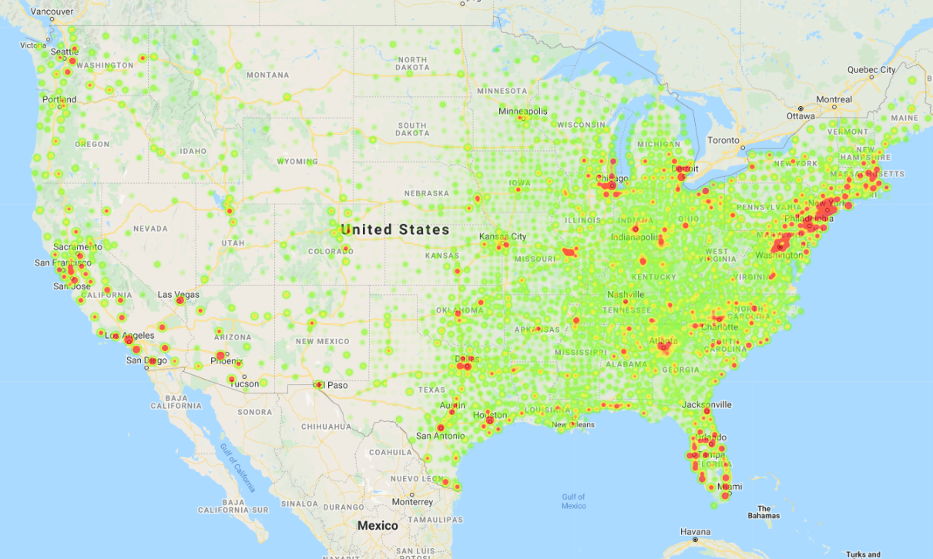
Data Analysis
Question 2:
Is the prevalence of diabetes higher in areas with and without a food desert?
Notes:
Sara

Slide 14
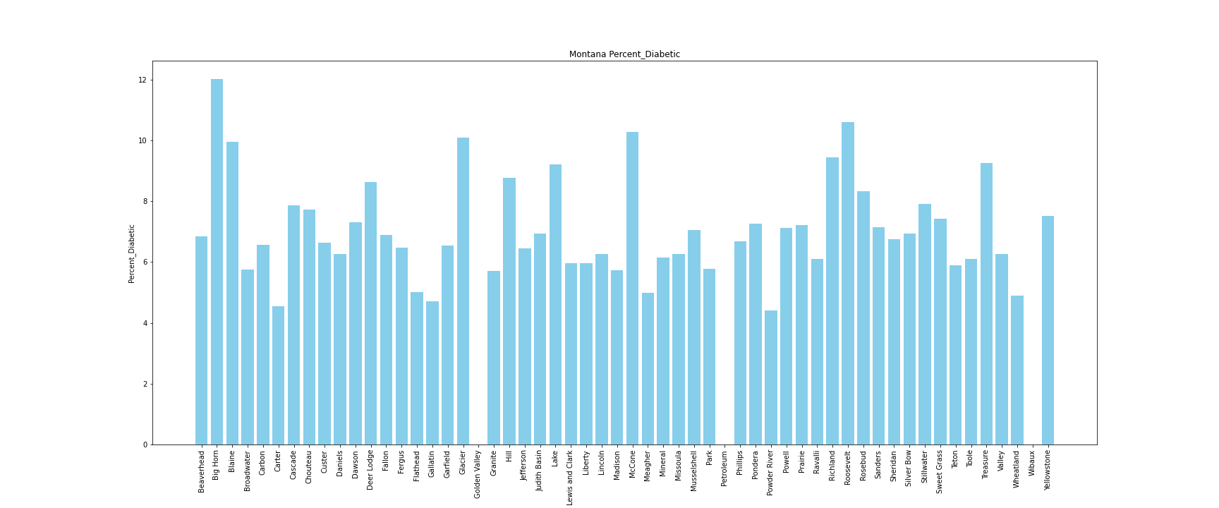
Data Analysis
Question 2:
Is the prevalence of diabetes higher in areas with and without a food desert?
Notes:
Tyler
In this bar chart, I identify the percentage of diabetus per county. As you can see, big horn county also has a high percentage, similar to the chart quantifying the percent of obese citizens.

Slide 15
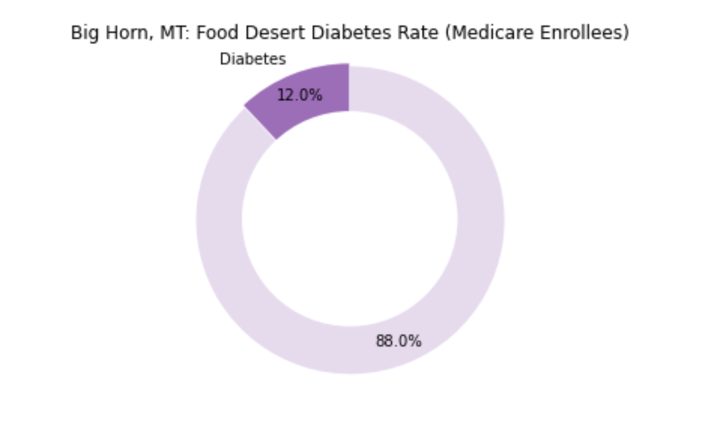
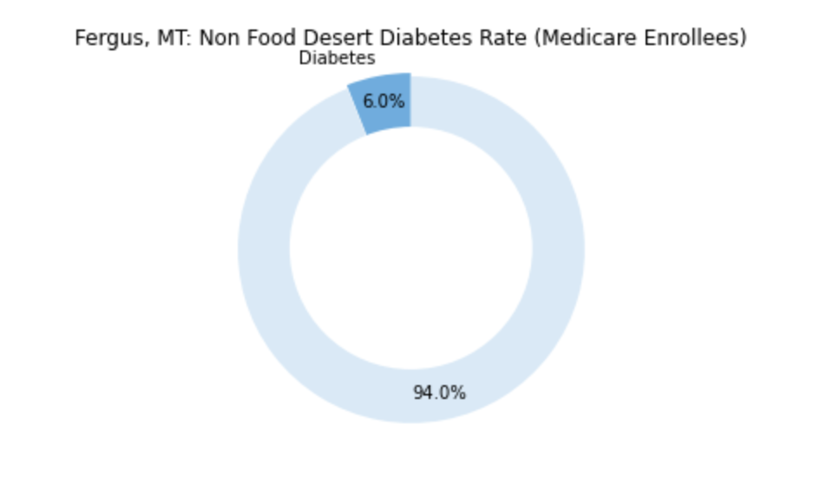
Data Analysis
Question 2: Is the prevalence of diabetes higher in areas with and without a food desert?
Notes:
Rachel
-Here, we compared the diabetes prevalence between Big Horn and Fergus again, and found that the food desert, Big Horn, had double the diabetes rate at 12%, where Fergus, the non-food desert, had a 6% diabetes rate.

Slide 16
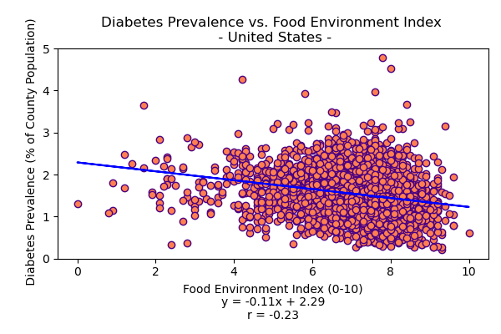
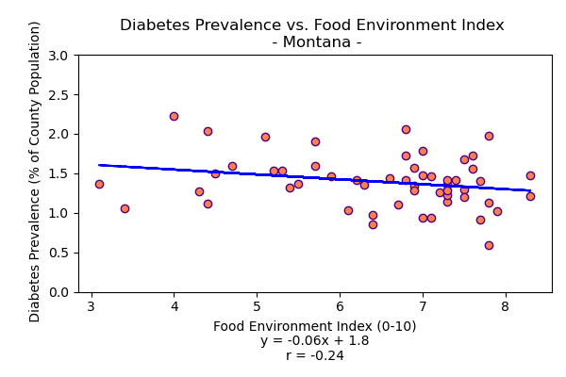
Data Analysis
Question 2: Is the prevalence of diabetes higher in areas with and without a food desert?
Notes:
Kasey

Slide 17
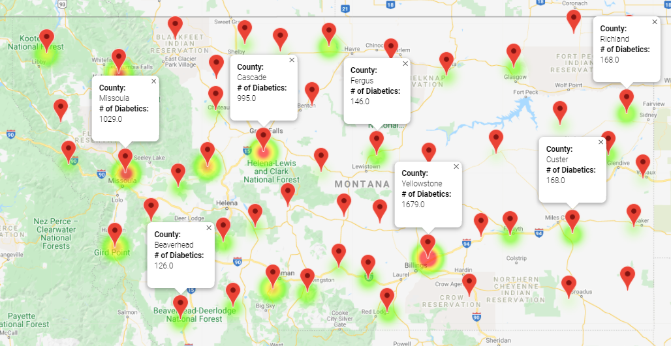
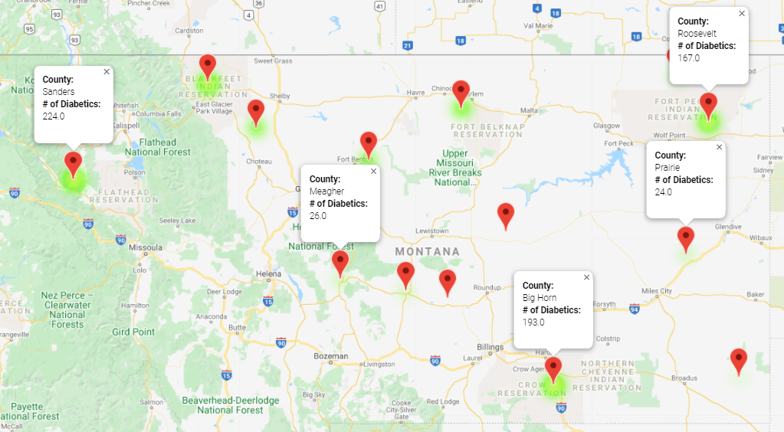
Data Analysis
Question 2: Is the prevalence of diabetes higher in areas with and without a food desert?
Non-Food Desert
Food Desert
Notes:
Sara

Slide 18
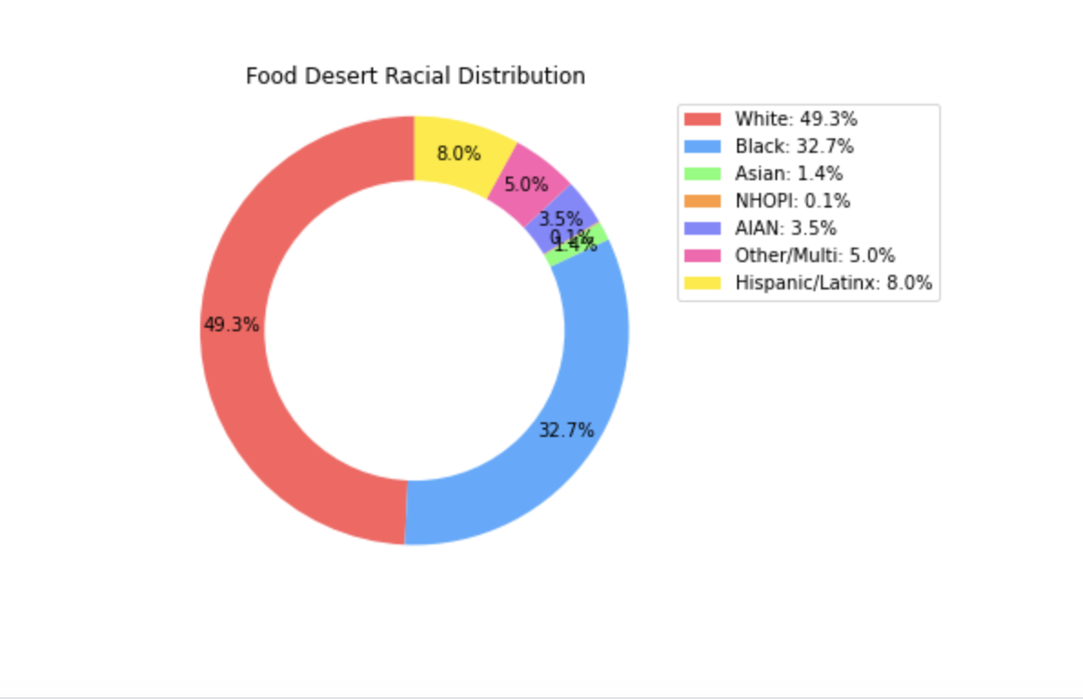
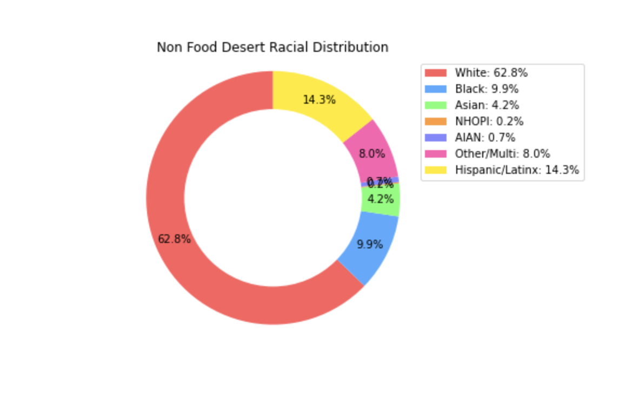
Data Analysis
Supplemental Analysis: We also reviewed the data to understand whether certain ethnicities are affected disproportionately by food deserts. This was best illustrated using the following pie charts.
Notes:
Rachel
-Although not directly related to health, we wanted to take a look comparing the racial distribution between food deserts and non food deserts, and this suggested disparity
-Here are graphs showing the racial makeup in the US, again grouped the same way by Food Environment Index. As shown here in blue, there is a nearly 23 percentage point difference in the black population in food deserts and non food deserts.

Slide 19
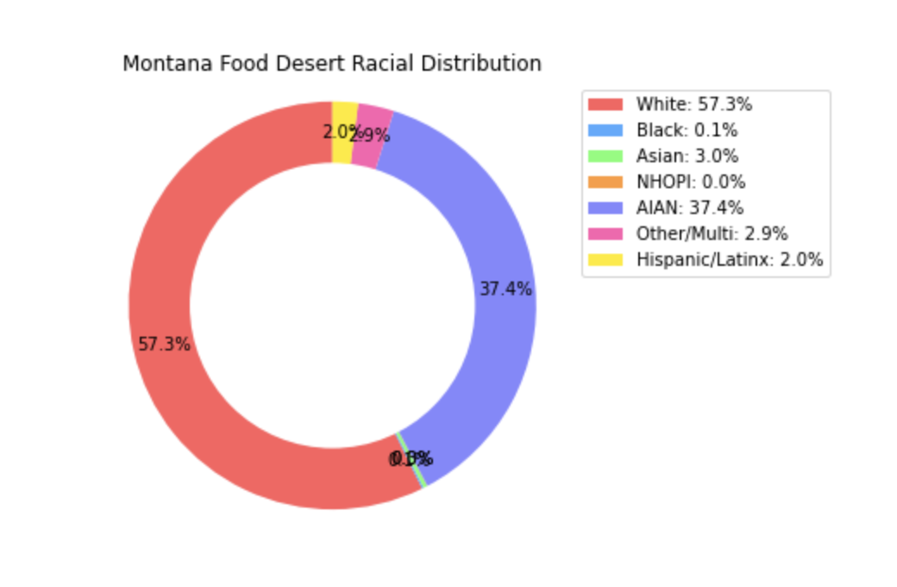
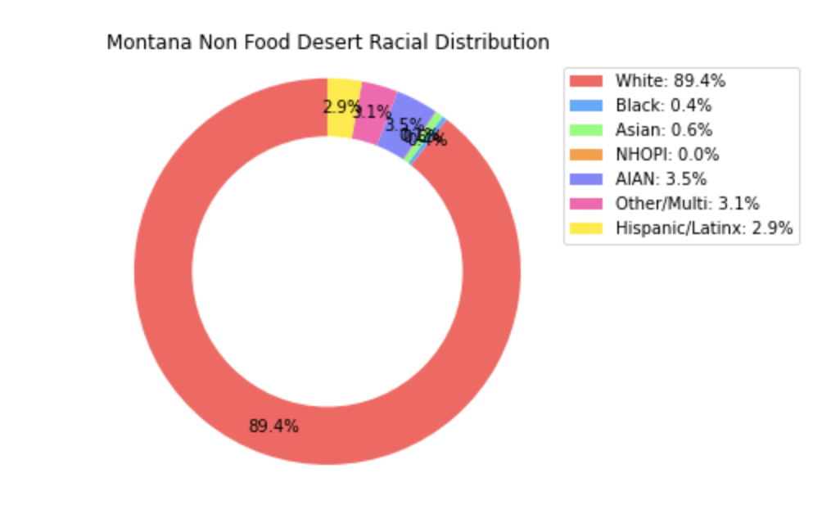
Data Analysis
Notes:
Rachel
-Shockingly, comparing the racial population in Montana food deserts vs non food deserts demonstrated a 34 percentage point difference in the American Indian and Alaska Native population, which is shown here in purple.

Slide 20
Conclusions
We expected to see a relationship between the presence of a food desert and the various health and economic factors. We found the following:
Obesity: Throughout the US as a whole, a slight correlation was found between obesity and populations within or outside of food deserts.
Lookly more closely, in Montana, there was a noticeable correlation in this relationship.
Diabetes: Throughout the US as a whole, there was no significant correlation between the prevalence of diabetes in populations within or outside of food deserts.
Lookly more closely, in Montana, there was a noticeable correlation in this relationship.
Throughout the US as a whole, certain ethnic populations are disproportionately affected by the presence of food deserts.
Notes:
Kasey

Slide 21
Post Mortem
Difficulties:
Finding datasets that could be merged appropriately.
Identifying the most representative fields to illustrate our hypothesis.
Possibly useful data details were consolidated during the merging process.
Additional research:
We would have like to find the health data on a census tract level, to better compare with the more refined food desert data.
Do a deeper dive into more health and socioeconomic factors that could relate to food deserts.
Analyze additional states for comparison.
Notes:
Tyler
Finding datasets that match for merging was one of the hardest tasks. Some had state but no county and some had county but no state. Others had state abbreviations while some were spelt out. We also had to identify fields that were actually meaningful for comparison.
I WISH WE COULD FIND HEALTH DATA ON THE CENSUS TRACT LEVEL ON TOP OF STATE AND COUNTY, BUT WE JUST COULDN’T. It certainly would’ve helped us dig deeper into the information. Analyzing additional states for comparison could’ve been useful too.

Slide 22
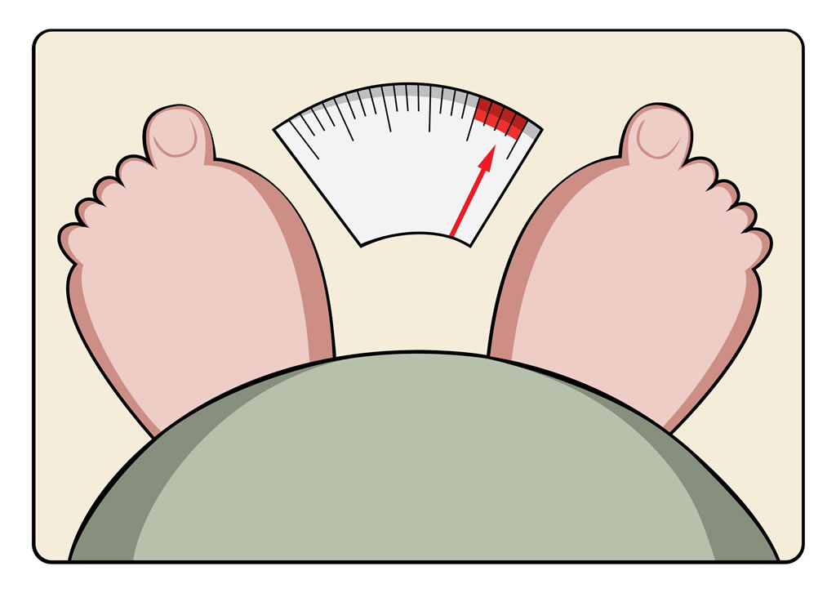

Questions ?

Slide 23
Sources:
Health Data:
https://www.countyhealthrankings.org/explore-health-rankings/rankings-data-documentation/national-data-documentation-2010-2018
Food Desert Data:
https://www.ers.usda.gov/data-products/food-access-research-atlas/download-the-data/
County Coordinates:
https://public.opendatasoft.com/explore/dataset/us-county-boundaries/map/?location=5,69.03242,-35.00244&basemap=jawg.streets
Medicare and Medicaid Services (CMS):
https://www.cms.gov/Research-Statistics-Data-and-Systems/Statistics-Trends-and-Reports/CMSProgramStatistics/2017/2017_Main

